Slide 1
Cyberbullying Text Classification
Submitted By:
Bailey Wang
Lakshmi Naga Meghana Polisetty
Sakshi Tongia

Slide 2
Background and Executive Summary
Young Americans are becoming increasingly concerned about cyberbullying. Creating powerful, humiliating, or derogatory messages about or to peers with technology intimidates, harasses, embarrasses, and controls them.
Cyberbullying statistics indicate that nearly 80% of adolescents use advanced cell phones on a daily basis, 92% go online at least once a day, and 56% go online frequently.
Adolescents and teens are particularly vulnerable to this, and it can cause anxiety, depression, and even self-destruction.
Cyberbullying mostly consists of harassing people in a negative way, frequently commenting on them based on their appearance, race, gender, or sexual orientation.

Slide 3
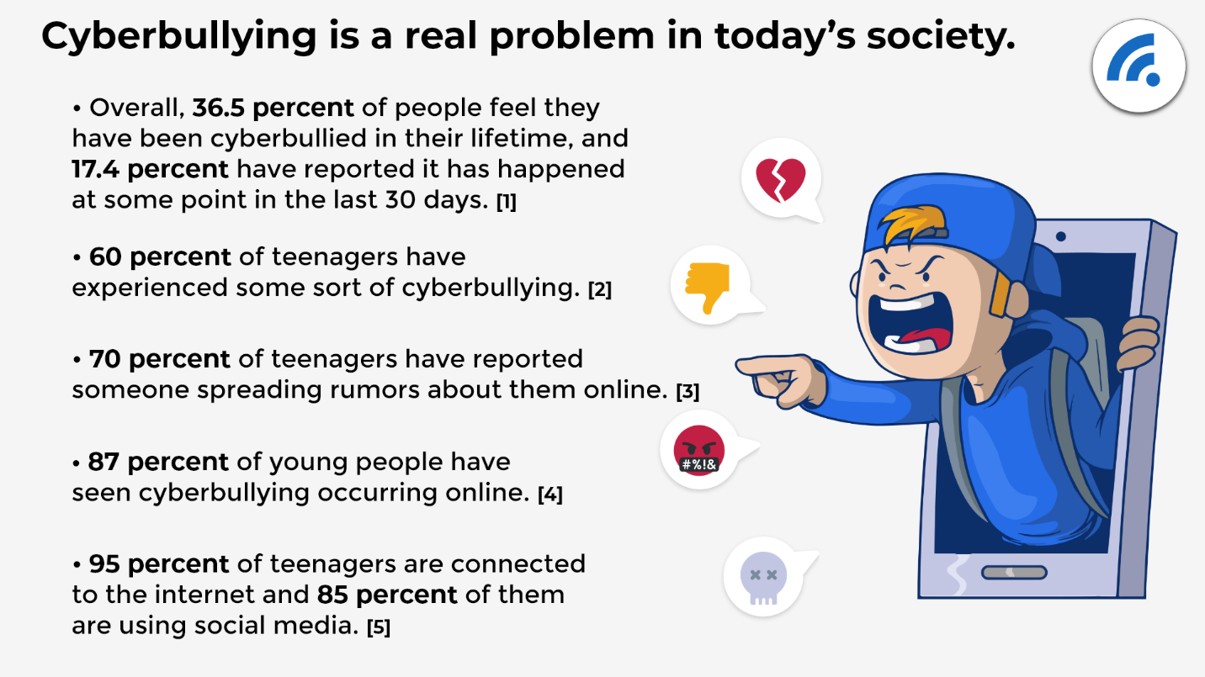
Project Motivation
Previous research was based on binary classification or sentiment analysis of the text classification
Project focuses on real-time Twitter data
Identify the best performing machine learning algorithms
Categorize the type of Cyberbullying into 7 labels: Non-Cyberbully, Sexual, Racial, Generic, Politics, Intelligence, Appearance

Slide 4
Deliverables
5th March
25th March
15th April
29th April
4th May
15th May
Business Understanding
Data & Project Management Plan
Data
Engineering
Model
Development
Evaluation & Evaluation Report
Prototype Deployment

Slide 5
Project Requirements
Data: Collect data from social media sites (Twitter, Reddit, Facebook)
Important Parameters: Username, Text Message
Target Labels: Non-Cyberbully, Sexual, Racial, Generic, Politics, Intelligence, Appearance
Classification Machine Learning Algorithm
Create
Create Data Cleaning Algorithms
Integrate
Integrate ETL streaming Pipeline (Apache Beam)
Connect
Connect with Google Cloud Storage, Google BigQuery
Compare
Compare model results with Model Evaluation Methods (F1-Score, Confusion Matrix, ROC curve)

Slide 6
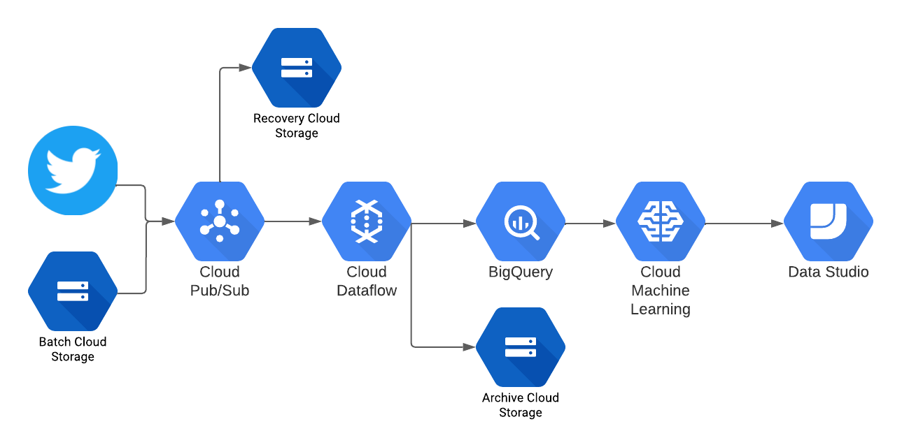
Project Architecture
Notes:
Twitter data (streaming) and batch data (storage) ingested combined together into the pipeline (create new CSV file for recovery storage)
Pub/sub pushes data through pipeline for DataFlow to apply ETL cleaning
Cleaned data is saved in Bigquery and Archive storage
Data is pushed to machine learning modeling afterwards
Results shown on DataStudio

Slide 7
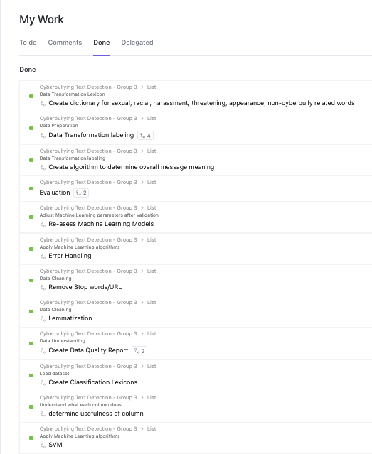
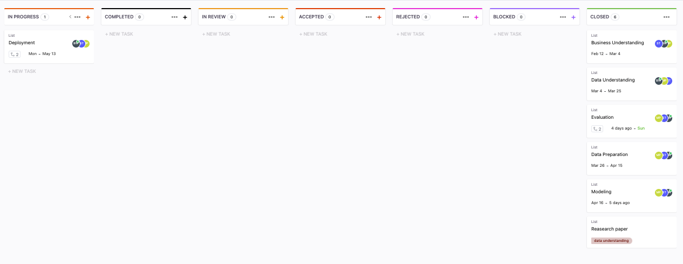
ClickUp

Slide 8
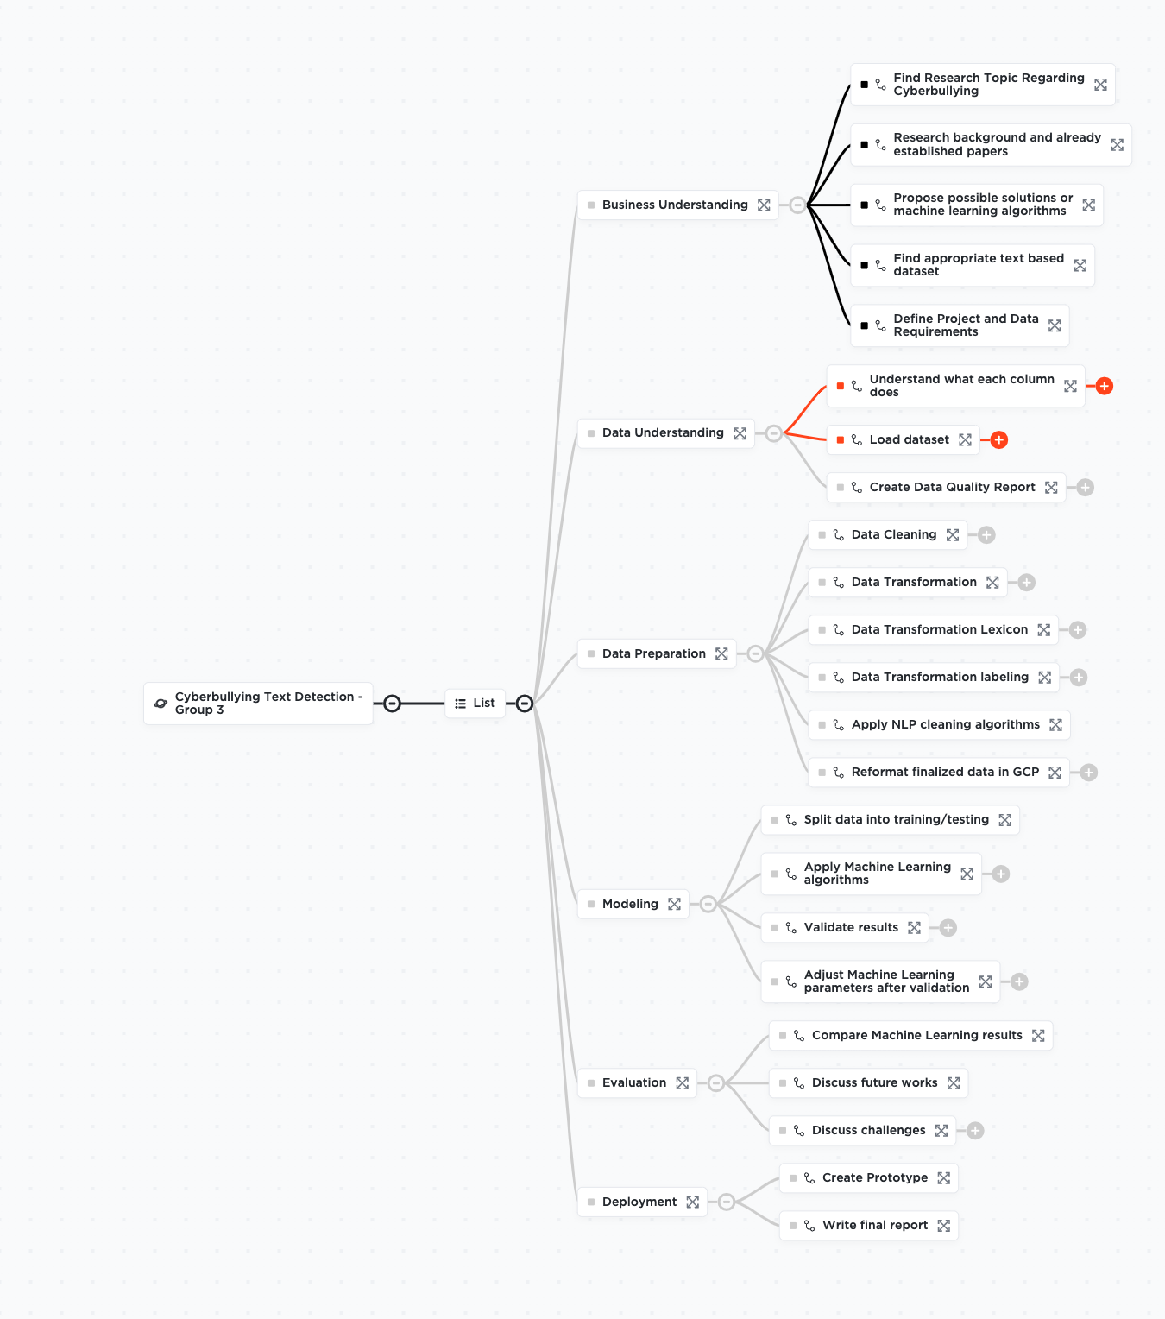
Work Breakdown Structure
To reduce complicated activities into a collection of tasks,we have defined a WBS for the project covering the CRISP-DM methodology.

Slide 9
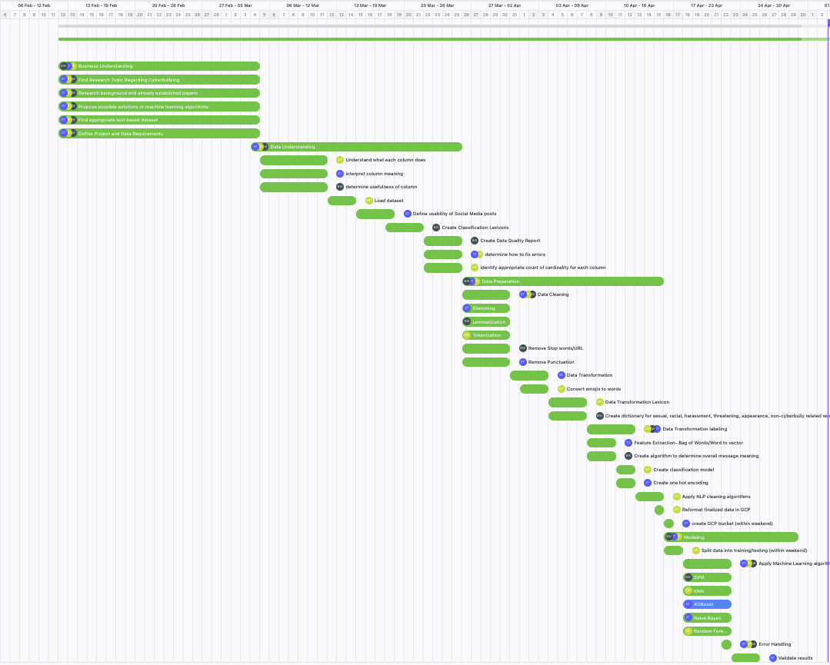
Gantt Chart
The project phases are well defined with elaborated tasks and a smaller number of iterations.
We have ensured each member of our team has sufficient bandwidth to work on different milestones.
Defining a Gantt chart for this project helped us identify the order in which we would’ve to complete our tasks and helped us stay on track.

Slide 10
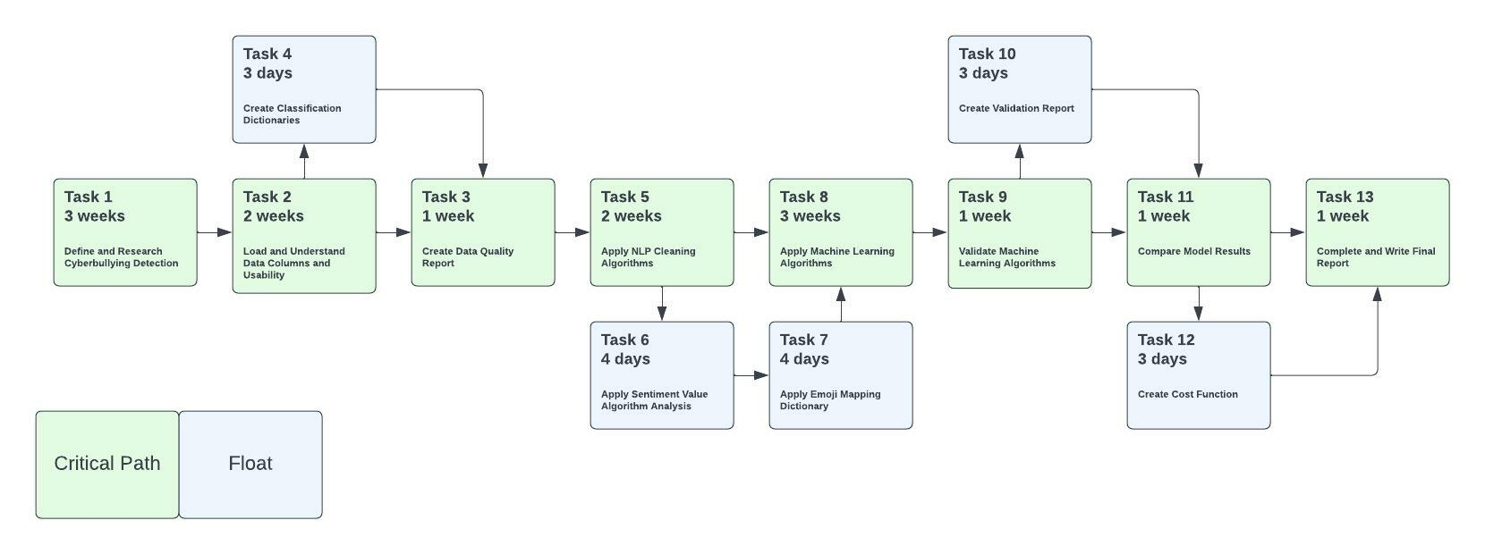
PERT Chart
Defined PERT chart to examine if the tasks in our project are scheduled according to the timelines and keep abreast with the milestones.
Identifying the critical paths in the project improved our decision making along the way.

Slide 11
Literature Survey
Authors | Data | Model | Accuracy | Conclusions
Yang & Chung (2019) | Twitter | - | 14% improvement | Updating existing dictionaries with new terminologies and emoticons improved sentiment analysis
Gujral (2017) | Twitter | Naive Bayes | NB: 70% | Main usage of uni-gram helps identify the malicious content
Mangaonkar, Hayrapetian, & Raje (2015) | Twitter | Logistic Regression, Naive Bayes, SVM | LR: 85% | The usage of n-gram helps increase the intent of the message
Talpur, & O’Sullivan (2020) | Twitter | Random Forest, KNN, SVM, Naive Bayes | RF: 91% | Efficiency in developing models to detect and determine the severity of the cyberbullying crime
Dalvi, Chavan, & Halbe (2020) | Twitter | Logistic Regression, Naive Bayes, SVM | SVM: 97% | Using different machine learning algorithms to determine whether a text is cyberbullying or not
Notes:
Yang: focused on emoticons, and how it improved accuracy for sentiment analysis
Gujral: uni-grams helped with sentiment analysis
Mangaonkar: handled different n-grams, uni-grams, bi-grams to understand the intent (sentiment analysis)
Dalvi: binary classification and multi classification, focus on whether a text is cyberbullying or not

Slide 12
Technology Survey
Model | Approach | Pro | Con
Logistic Regression | Explain the relationship between one dependent binary variable with 1+ independent variables | Measures how relevant a predictor is, and the positive/negative association | Linearity assumption Only used to predict discrete variables
SVM | Separates the group by finding the best line | Memory efficient where there are large amounts of dimensions | Unsuitable for large data
Random Forest | Uses an ensemble of Decision Trees and picks the highest voted result | Handle missing values, unaffected by noise | Overfitting
Naive Bayes | Uses conditional probability to calculate the probabilities | Works on non-linear | Independent assumption
KNN | Calculate the similarity with the data using distance formula | Easy implementation, new data may be added easily | Affected by noise, missing data, or outliers
Notes:
LR - relevance of predictor-imp for sentiment analysis, but its linearity assumption makes it predict discrete variables
SVM - good with large dimensionality but does not work well with large amount of data
Naive bayes - works well with non-linear, it assumes independence between variables

Slide 13
Project Resource Requirement & Plan
Function | Resource Type | Resource | Duration | Cost
Computer | Hardware | Windows, iOS | 6 months | $1000-$2000 (single payment)
Software Development | Software | Python 3.8.7+ | 6 months | Free
Machine Learning Framework | Software | SKLearn | 6 months | Free
Project Management | Software | ClickUp | 6 months | Free (trial)
Document Management | Software | Google Drive | 6 months | Free
Virtual Machine | Software | Compute Engine (n1-standard 1 CPU, 4GB) | 6 months | $11.65 per month
Cloud Storage | Hardware | Standard Storage (1TB) | 6 months | $20.48 per month
Recovery Storage | Hardware | Coldline Storage (1TB) | 6 months | $4.10 per month
Long Term Storage | Hardware | Archive Storage (1TB) | 6 months | $1.23 per month
Relational Database Storage | Hardware | Google BigQuery (1TB) | 6 months | $23.32 per month
Streaming Pipeline | Software | Google DataFlow | 6 months | $0.07 per month
Visualization | Software | Google DataStudio | 6 months | Free
Python
Google Cloud Platform
Cloud Storage
BigQuery
DataFlow
DataStudio
Compute Engine
Clickup
Notes:
Computer: uses windows/ios to access Python
Python: main scripting language
ML: SKlearn library
Compute Engine: as virtual machine
Project management: ClickUp
Storage: 3 different cloud storage: daily use (standard), recovery (coldline), long-term (archive)
BigQuery: SQL relational database after the pipeline
DataFlow: main pipeline function

Slide 14
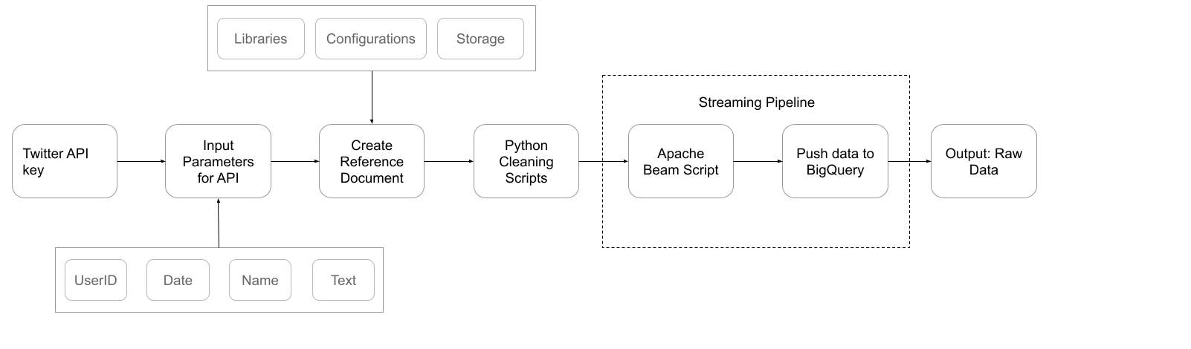
Data Collection Pipeline

Slide 15
Raw Data & Parameters
Parameters | Values
Data Source | Data scrapped from Twitter using the Twitter API
Memory Usage | 73.2+ MB
Data Columns | Column name | Unique Values | Data Type
 | Sentiment: 1600000 values | 2 | int64
 | ID : 1600000 values | 1598315 | int64
 | Date: 1600000 values | 774363 | object
 | Text: 1600000 values | 659775 | object
 | User: 1600000 values | 1581466 | object
 | Flag: 1600000 values | 1 | object

Slide 16
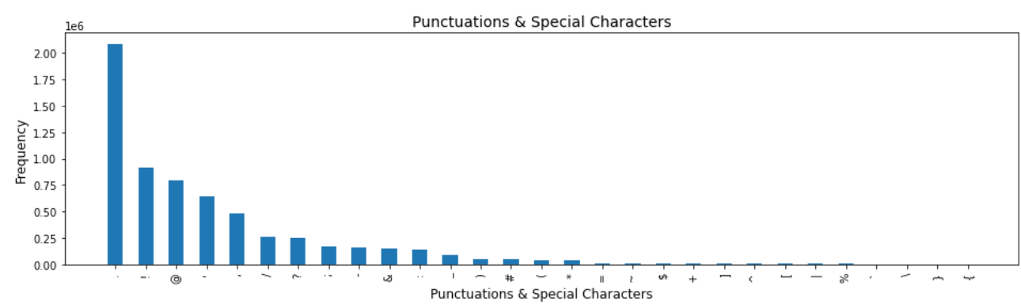
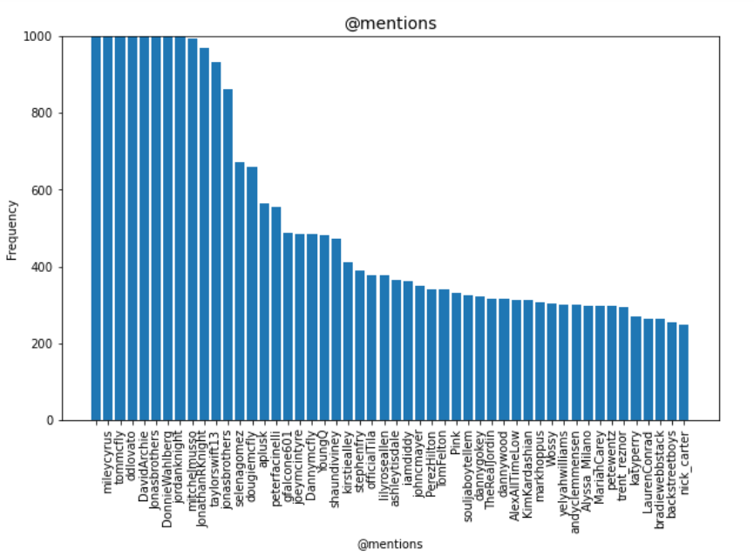
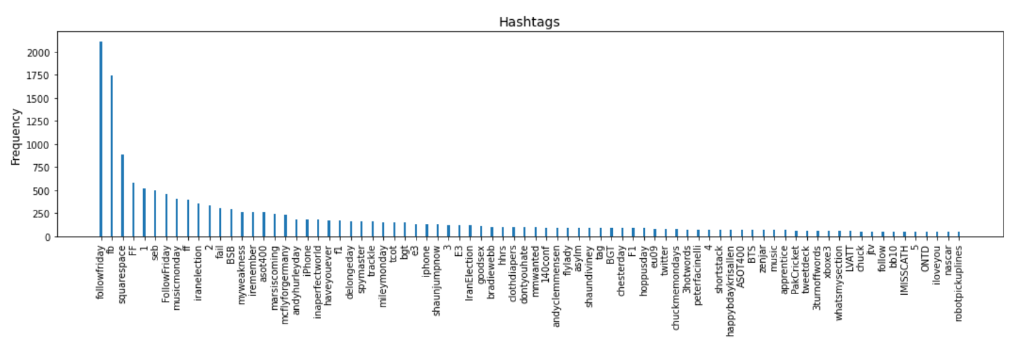
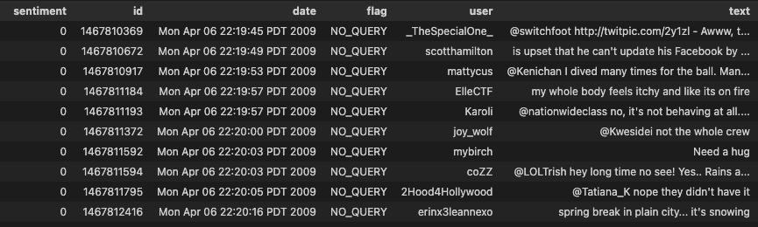
Data Preprocessing| Raw Data
Notes:
Inconsistent semantics
Hyperlinks,
Upper lower casing
Mentions, hashtags Punctuation marks
All resulting in unstructured data

Slide 17
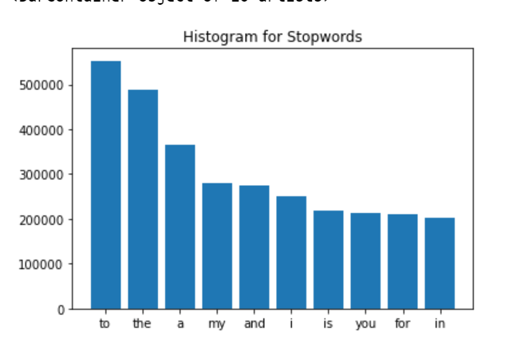
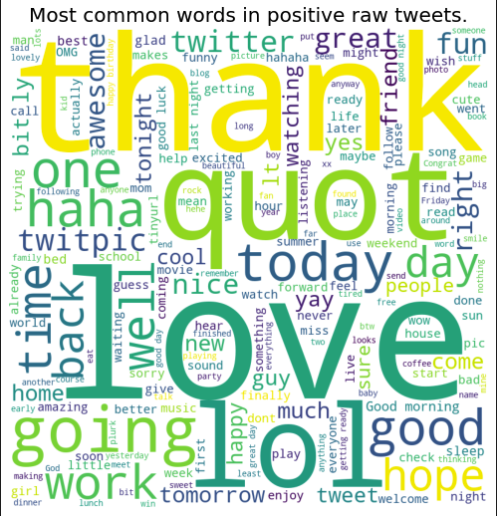
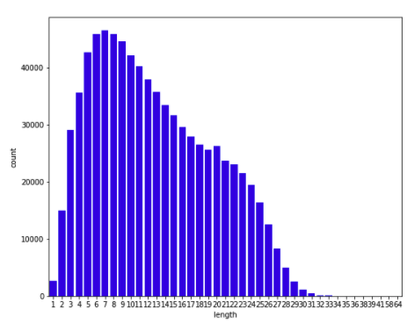
Data Preprocessing| Raw Data
Notes:
Next, we also saw the sentiment distribution in raw data.

Slide 18
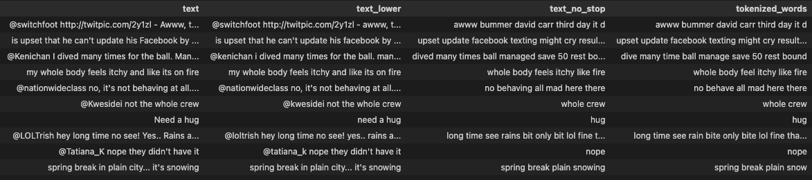
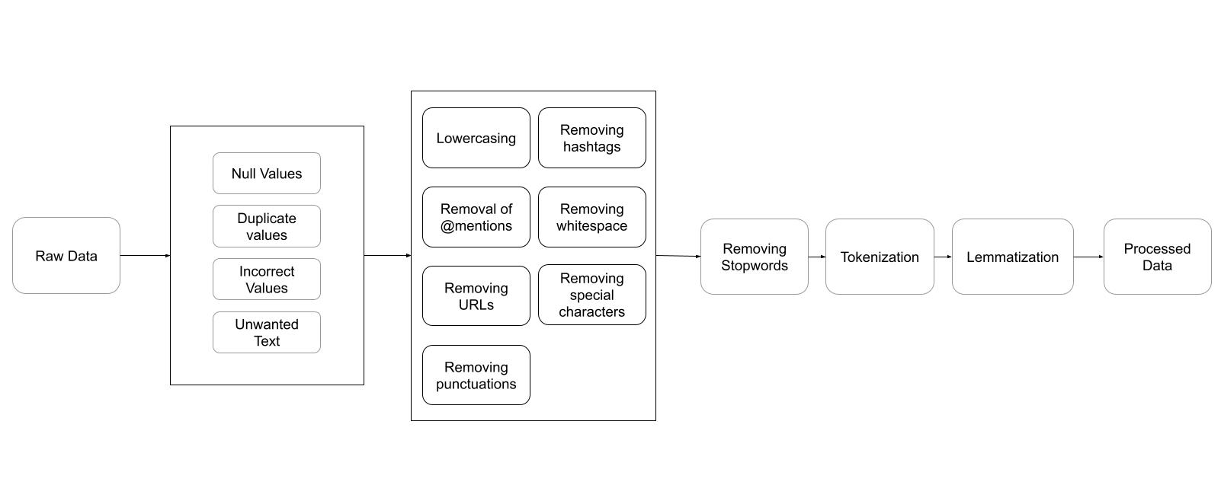
Raw Data Transformed to Clean Data
Notes:
Tokenization - first splits paragraphs to sentences, then sentences to words known as tokens
Lemmatization- these tokens are then passed through a lemmatizer which help in converting words to its root canonical form.

Slide 19
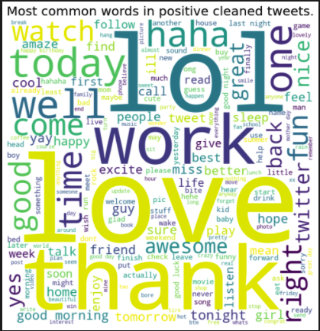
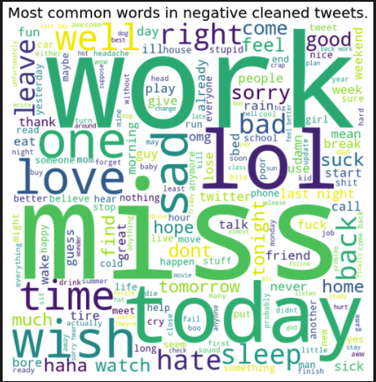
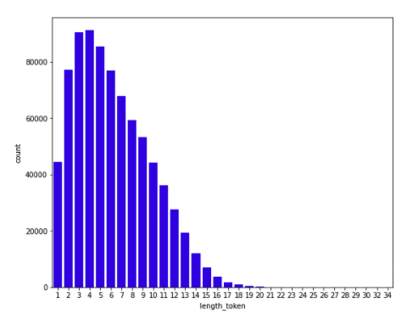
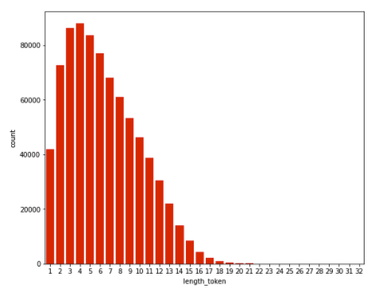
Data Exploration | Cleaned Data
Notes:
Polarity distribution and word clouds

Slide 20

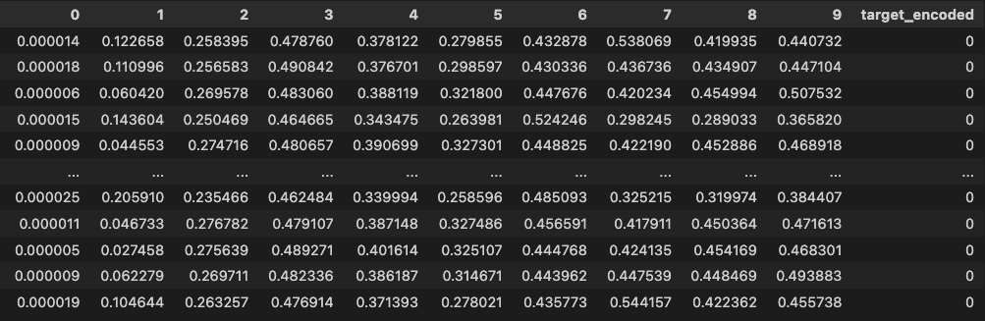
Data Transformation
Notes:
Applied data regularization and data reduction
Created a new dataframe with the targeted label (encoded)

Slide 21
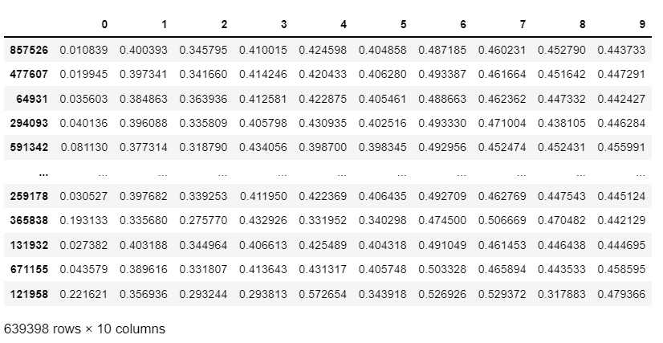
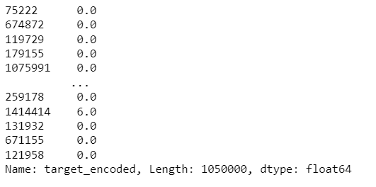
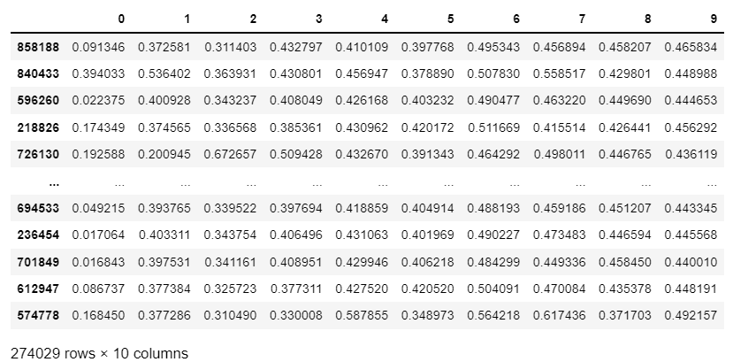
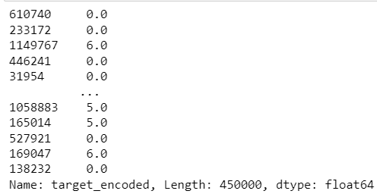
Data Splitting
X_train
y_train
X_test
y_test

Slide 22
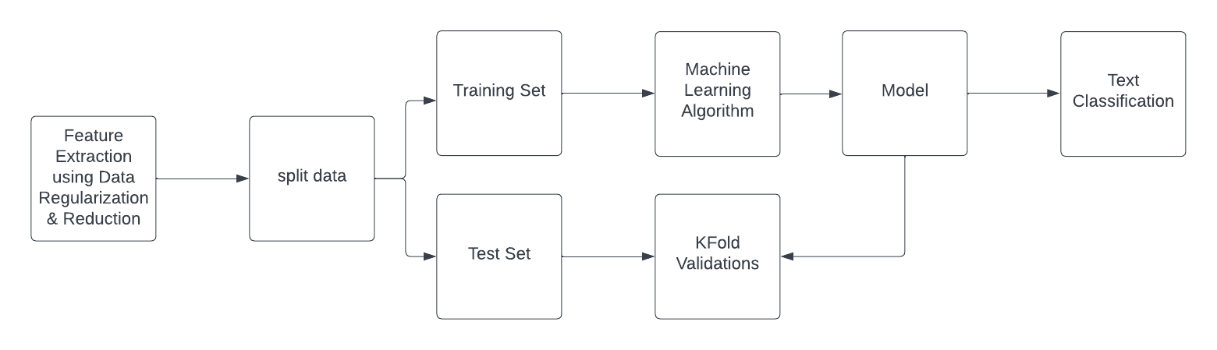
Machine Learning Architecture

Slide 23
Model Selection: Comparison & Justification
Model | Pros | Cons | Justifications
Logistic Regression | Efficient Computation Large data Classification and Regression | Overfitting (small data) Data Preparation is important (scale/normalization) Missing Data | - Great with large data - Works well with linear data
SVM | Good for large dimensions Classification and Regression | Small data Overfitting High computation Scaling required | - Scales with high dimensional spaces - Works well with unstructured data - Kernel trick facilitates solving complex problems.
Naive Bayes | Simple to implement Efficient computation Classification | Biased: each feature is considered independent | - Ad hoc model updates - Works well with large data

Slide 24
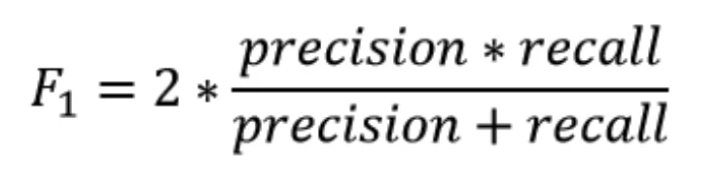
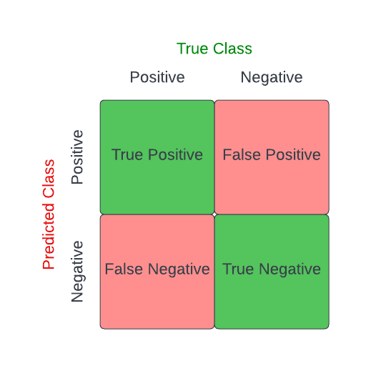
Model Evaluation Methods
F1 Score
Precision-Recall
Confusion Matrix
Roc Curve
Notes:
F1-Score: uses precision and recall useful for imbalance data
P: how good the model is at predicting a specific category
R: how many times the model was able to detect a specific category
Confusion Matrix:
ROC: show how well the model predicts the class

Slide 25
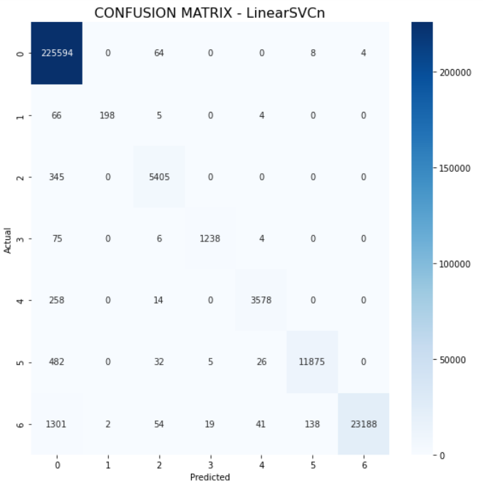
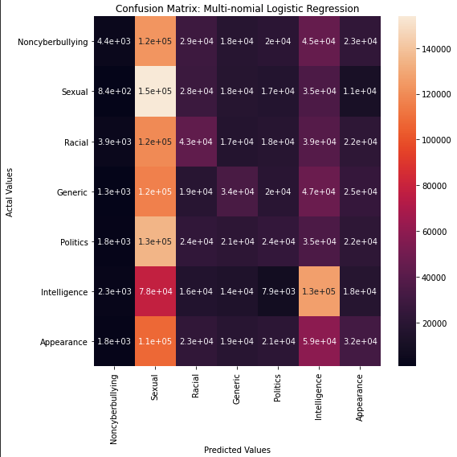
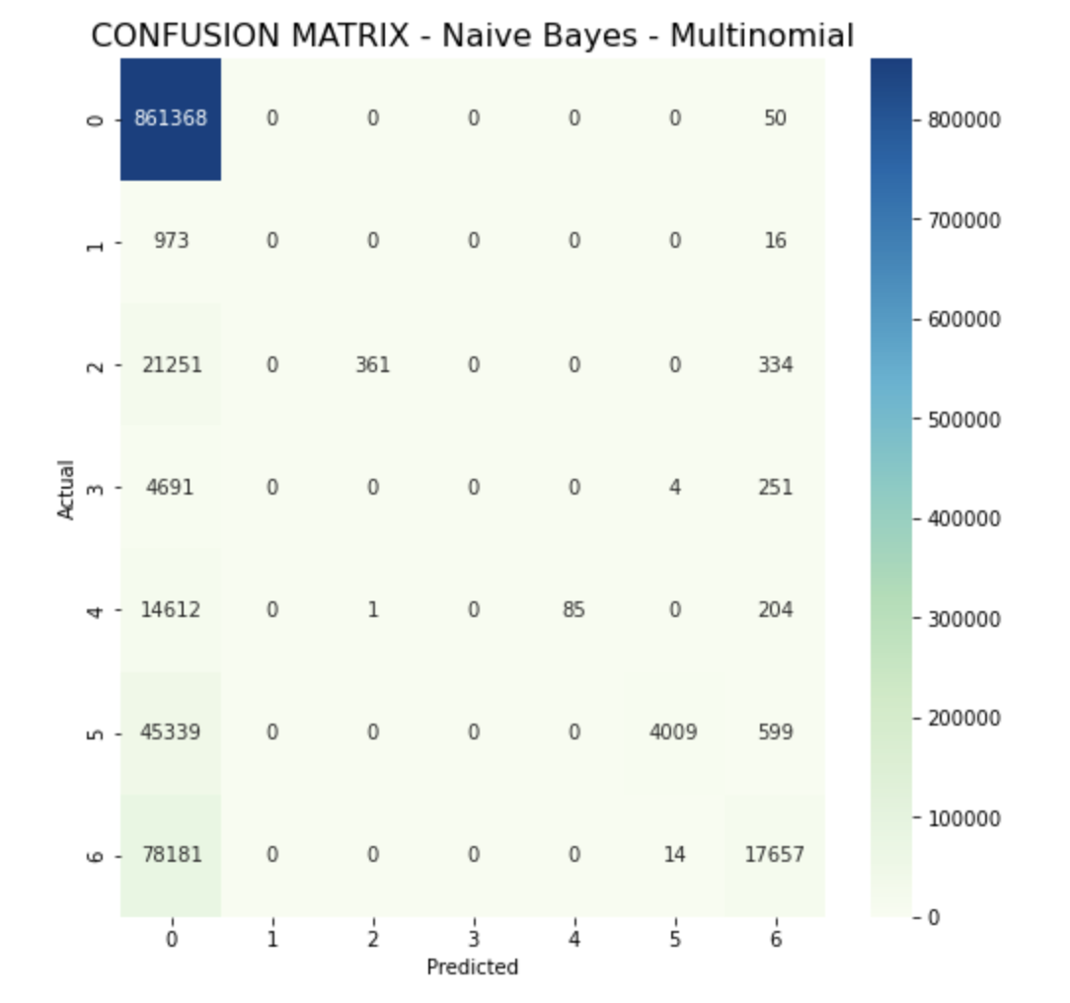
Model Results |Confusion Matrix
Linear SVC
Multinomial Logistic Regression
Naive Bayes

Slide 26
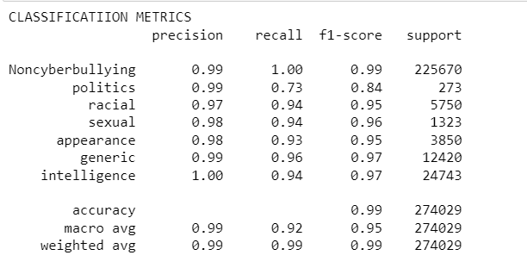
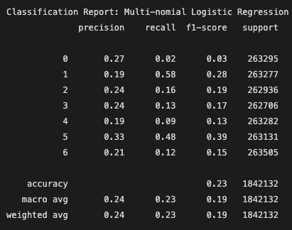
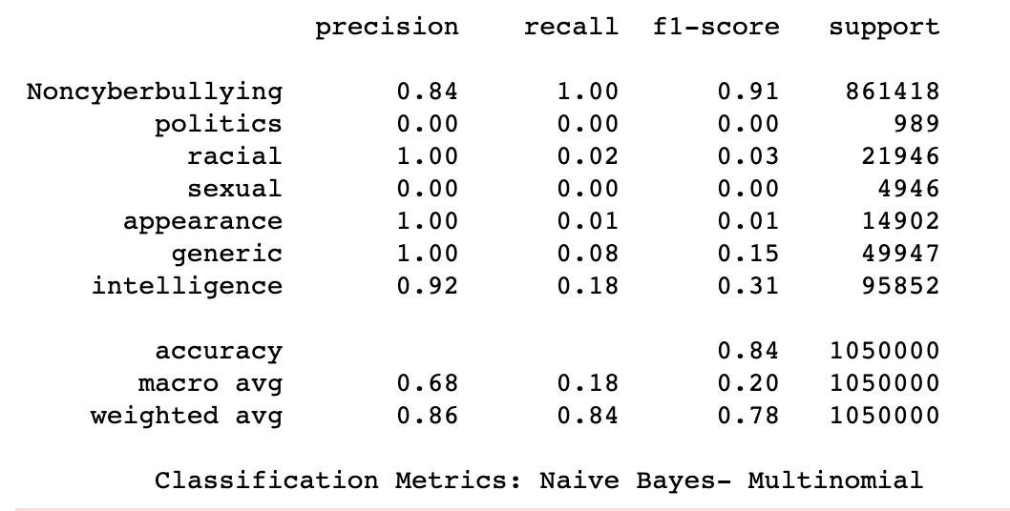
Model Results | Classification Report
Linear SVC
Multinomial Logistic Regression
Naive Bayes

Slide 27
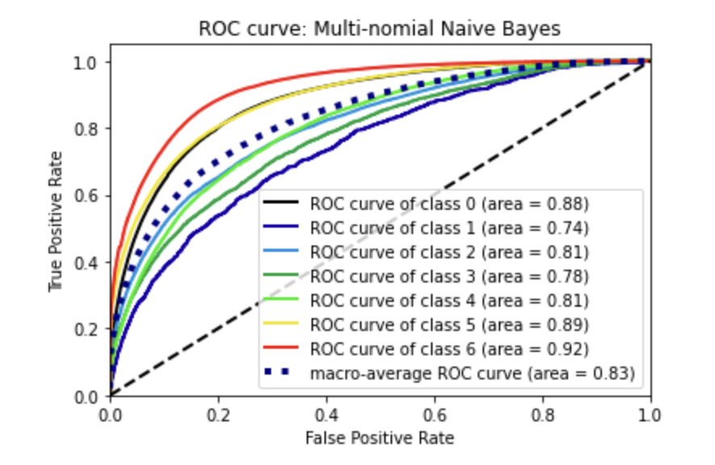
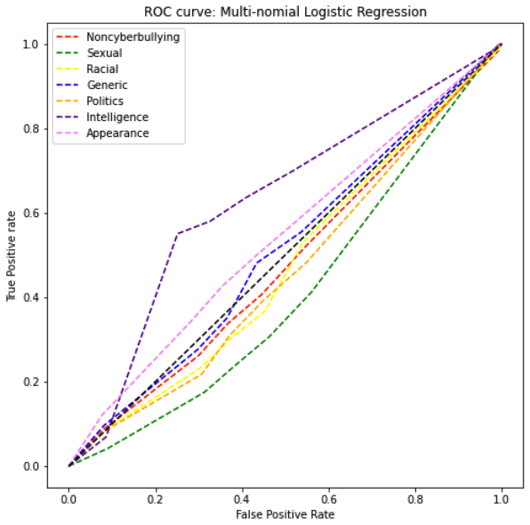
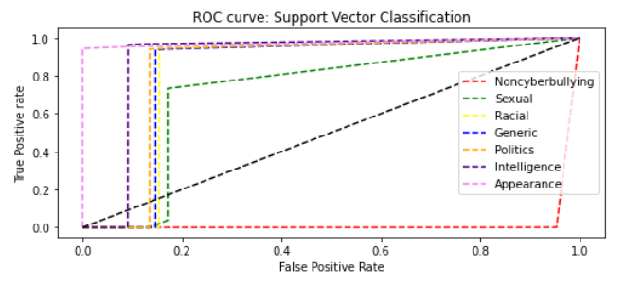
ROC Curve

Slide 28
References
All the Latest Cyber Bullying Statistics and What They Mean In 2022. (2022). BroadbandSearch.Net. Retrieved May 6, 2022, from https://www.broadbandsearch.net/blog/cyber-bullying-statistics
Dalvi, R., Chavan, S., & Halbe, A. (2020, May 1). Detecting A Twitter Cyberbullying Using Machine Learning. IEEE Conference Publication | IEEE Xplore. Retrieved February 27, 2022, from https://ieeexplore.ieee.org/abstract/document/9120893
Jose, K. (2021, December 13). Explaining how ROC curve works - Analytics Vidhya. Medium. Retrieved April 29, 2022, from https://medium.com/analytics-vidhya/explaining-how-roc-curve-works-df7b46df6e65
Gandhi, R. (2018, July 5). Support Vector Machine - introduction to machine learning algorithms. Medium. Retrieved February 17, 2022, from https://towardsdatascience.com/support-vector-machine-introduction-to-machine-learning-algorithms-934a444fca47
Gujral, S. (2017, August 1). International Journal of Computer Sciences and Engineering. Ijcseonline.Org. Retrieved March 1, 2022, from https://www.ijcseonline.org/full_paper_view.php?paper_id=1410
Mangaonkar, A., Hayrapetian, A., & Raje, R. (2015, October 8). Collaborative detection of cyberbullying behavior in Twitter data. IEEE Conference Publication | IEEE Xplore. Retrieved March 1, 2022, from https://ieeexplore.ieee.org/abstract/document/7293405
Precision-Recall. (2022). Scikit-Learn. Retrieved April 30, 2022, from https://scikit-learn.org/stable/auto_examples/model_selection/plot_precision_recall.html
Ray, S. (2021, August 26). Learn naive Bayes algorithm: Naive Bayes classifier examples. Analytics Vidhya. Retrieved February 17, 2022, from https://www.analyticsvidhya.com/blog/2017/09/naive-bayes-explained/
Swaminathan, S. (2019, January 18). Logistic regression - detailed overview. Medium. Retrieved February 17, 2022, from https://towardsdatascience.com/logistic-regression-detailed-overview-46c4da4303bc
Talpur, B. A., & O’Sullivan, D. (2020, October 27). Cyberbullying severity detection: A machine learning approach. Plos One. Retrieved March 2, 2022, from https://journals.plos.org/plosone/article?id=10.1371/journal.pone.0240924
Yang, J. S., & Chung, K. S. (2019, May 13). Newly-coined words and emoticon polarity for social emotional opinion decision. IEEE Xplore. Retrieved February 17, 2022, from https://ieeexplore.ieee.org/document/8711413

Slide 29

Questions

